Slide 1
Lecture 2: 29 December 2022
Laws of Inheritance (final part)
LIF111/101
Introduction to Genetics
https://www.youtube.com/watch?v=B_PQ8qYtUL0&t=12s&ab_channel=FrankGregorio
You can play this simple animation for Mendelian genetics
https://www.youtube.com/watch?v=Mehz7tCxjSE&ab_channel=TED-Ed

Slide 2
RECAP
What is assumed here?
Assumption:
For each trait there is one pair of alleles
Law of segregation
Alleles (factors) representing a given trait segregate (separate) during gamete formation, and randomly unite at fertilization.
An interpretation based on first & second law of probability:
Each gamete receive only one of the two alleles (factors)
How this inference was drawn?
How to read ? Example
http://en.wikipedia.org/wiki/Mendelian_inheritance

Slide 3
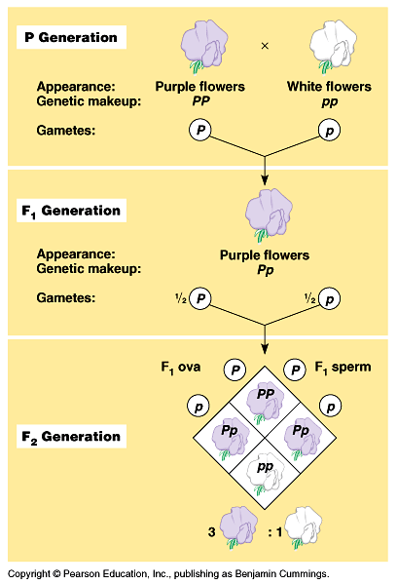
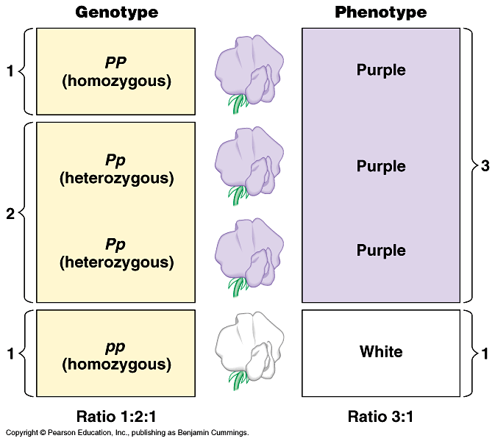
RECAP
This is also called a monohybrid cross. Why??
4/21

Slide 4
RECAP
Test cross
Purple X White
Pp pp
Explain the design/purpose of this cross
??
What does this cross reveal?
5/21

Slide 5
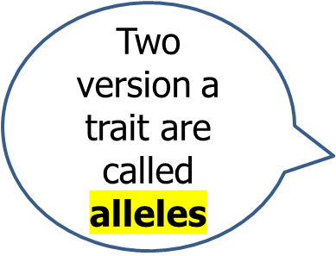
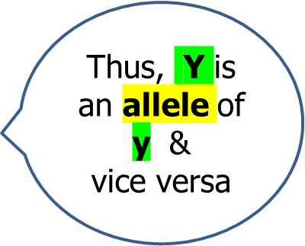
Let’s consider inheritance of two different pairs of factors
What does R and r mean?
Which one is dominant?
Character : texture of the seeds
Traits smooth (R ) and rough ( r)
Character : color of the seeds
Traits yellow (Y) and green (y)
If a plant is true breeding smooth and yellow – how can we represent its genotype?
RRYY
If a plant is true breeding rough and green – how can we represent its genotype?
rryy

Slide 6
What will be the consequence if a true breeding smooth and yellow plant is crossed with another true breeding plant which is rough and yellow?
P1
RRYY X rryy
8/21

Slide 7
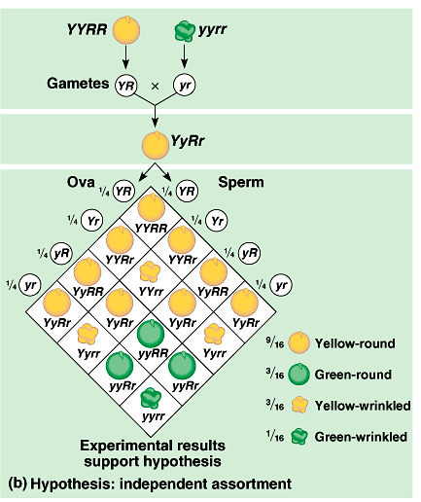
What happens in the F2 generation?
First, find the types of gametes that are possible
F1
X
YyRr
Why this is called law of independent assortment
Second, speculate the outcome if factors of original parent segregate together
F2

Slide 8
Law of Independent assortment
(This law tells how different Mendelian factors are distributed following segregation)
The Law of Independent Assortment states that segregating alleles of different genes assort independently of one another during gamete formation.
10/21

Slide 9
P1
Your homework:
Explain when the first and second laws of probability comes into operation
F1
F2
The dihybrid ratio

Slide 10
Explain why did Mendel took two contrasting factors to demonstrate this rule of inheritance, namely, the law of segregation?
What is the modern term for Mendelian factors?

Slide 11
Use the following words to complete the sentence below. dominant, homozygous, non-identical, heterozygous, identical
All non-reproductive cells contain two alleles of each gene. When those alleles are ____________, the cell is said to be _____________. When those alleles are _____________, the cell is said to be _______________, in which case the cell’s (or organism’s) phenotype is dictated by the _____________ allele.
17/21

Slide 12
One gene has alleles A and a. another has allele B and b. For each of the four genotypes below, what type(s) of gametes will form? Assume independent assortment occurs.
a. AABB
b. AaBB
c. Aabb
d. AaBb
Parental genotype | Gamete types formed
AABB | AB
AaBB | AB (1/2) & aB(1/2)
Aabb | Ab (1/2), ab(1/2)
AaBb | AB (1/4), Ab (1/4) aB (1/4), ab (1/4) | Explain why there are four types of gametes
Which set of gametes display evidence of independent assortment?
19/21

Slide 13
Home work
2. What will be the genotypes of offspring from the following matings? Indicate the frequencies of each genotype among
a. AABB x aaBB
b. AaBB X AABb
c. AaBb X aabb
d. AaBb X AaBb
Step 1: In each case, first identify the types gametes formed by each parent
Step 2: Place these gametes at the designated position in a Punnett square
Step 3. Display the genotypes of the products of fusion of these various gametes in the Punnett square
Step 4. Describe the phenotypes of the genotype of the progeny and their ratios
20/21

Slide 14
Use the following words to complete the sentence below allele(s), diploid, gamete(s), gene, haploid
A ______organism contains two _____ of each ______ in all cells except its _________which are _________ and contain only one.
16/21

Slide 15
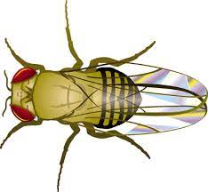
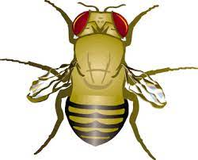
Fruit fly, Drosophila
X
Wild type
vestigial mutant
What should be the mutant allele symbol?
Allele symbol: Vg
Information: mutant is recessive
vg
What should be the genotype of the mutant fly?
vg/vg
What could be the genotype of the wild type fly
Vg/Vg
Vg/vg

Slide 16
Cross wild type &
vg mutant
X
Wild type
vestigial mutant
Step 1
Write their genotype
Vg/Vg
vg/vg
Step 2
Write genotypes of their gametes
Vg
vg
Step 3
Write genotypes the F1 progeny
Vg/vg
Step 4
Mention the phenotype of F1 progeny

Slide 17
What was the genotype of this parent
X
Wild type
vestigial mutant
How would you explain this outcome?
F1 progeny
50%
50%

Slide 18
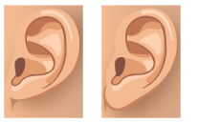
Earlobe attached
Earlobe free
Which one should be Ff and which one ff
Add symbol
Father
Mother
Ff and ff
Children
50%
50%

Slide 19
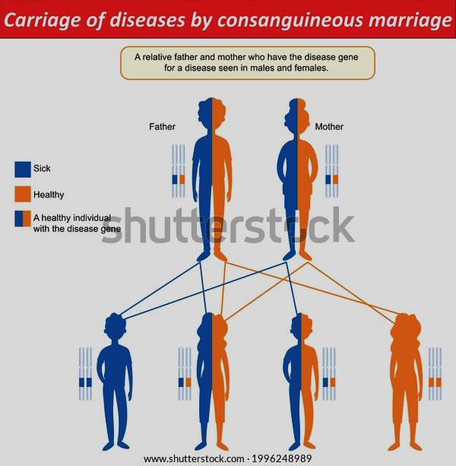
Does understanding Mendelian genetics make practical sense to our life?
Why marriage amongst near relative is not a good idea?
β Thalassaemia
What is inbreeding?
What is consanguineous marriage

Slide 20

Can you inherit genes that may give rise to a disease later on?
On average, a woman with a BRCA1 or BRCA2 gene mutation has up to a 7 in 10 chance of getting breast cancer by age 80. If you have inherited a mutated copy of either gene from a parent, you have a higher risk of breast cancer.
Breast Cancer Gene Testing Kits
The first FDA-approved breast cancer gene test kit supplied by 23andMe, a company that is popular for producing reports that identify a person’s ancestry
23andMe Holding Co. is a publicly held personal genomics and biotechnology company based in South San Francisco, California

Slide 21
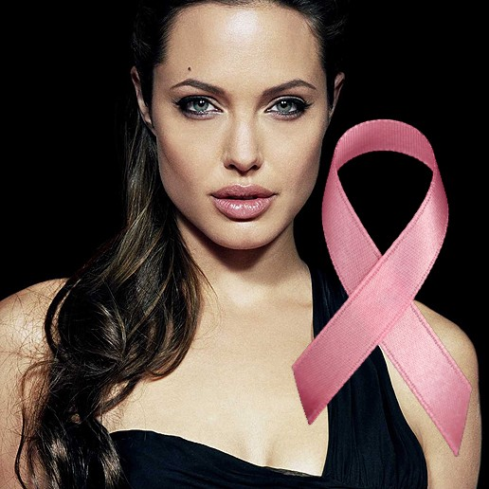
Application of these understanding of Mendelian genetics in our own life
Cancer prevention treatment
On February 16, 2013, the 37-year-old Jolie underwent a preventive double mastectomy after learning she had an 87 percent risk of developing breast cancer due to a defective BRCA1 gene.
Her maternal family history warranted genetic testing for BRCA mutations: her mother, actress Marcheline Bertrand, had breast cancer and died of ovarian cancer, while her grandmother died of ovarian cancer. Her aunt, who had the same BRCA1 defect, died of breast cancer three months after Jolie's operation. The mastectomy, which lowered her chances of developing breast cancer to under five percent.
Two years later, in March 2015, after annual test results indicated possible signs of early ovarian cancer, she underwent a preventive removal of an ovary and its fallopian tube, as she had a fifty percent risk of developing ovarian cancer due to the same genetic anomaly.

Slide 22

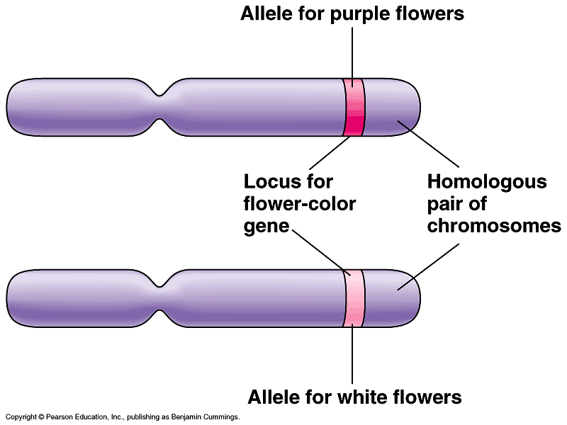
Mendel explained inheritance in pea in 1865 – it was not called a law in those days – it was hardly noticed. The physical basis of Mendelian inheritance became evident when chromosomes were discovered and their transmission in somatic cells (by Mitosis) and Gametes (Meiosis) was understood in the early 1900s
Summary of our current understanding

Slide 23
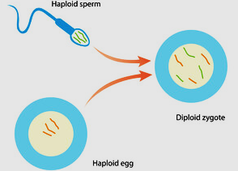
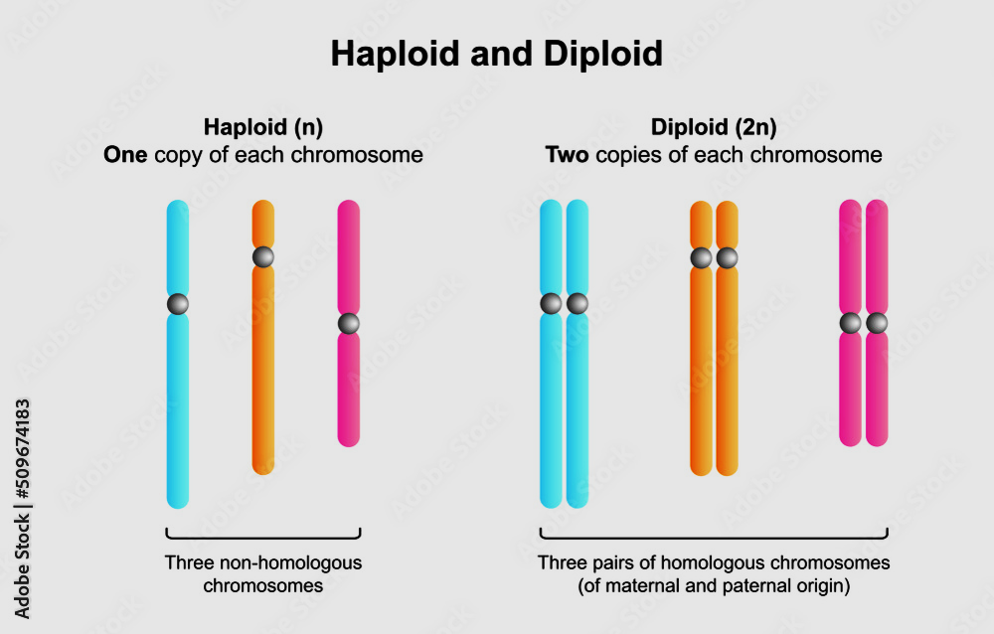
Some terminologies
Gamete
Gamete
Haploid
Diploid
Chromosomes
Notes:
Gamete: a mature haploid male or female germ cell which is able to unite with another of the opposite sex in sexual reproduction to form a zygote
Haploid: Cells or organisms having a single set of unpaired chromosomes
Diploid : Cell or organisms having two complete sets of chromosomes, one from each parent.

Slide 24
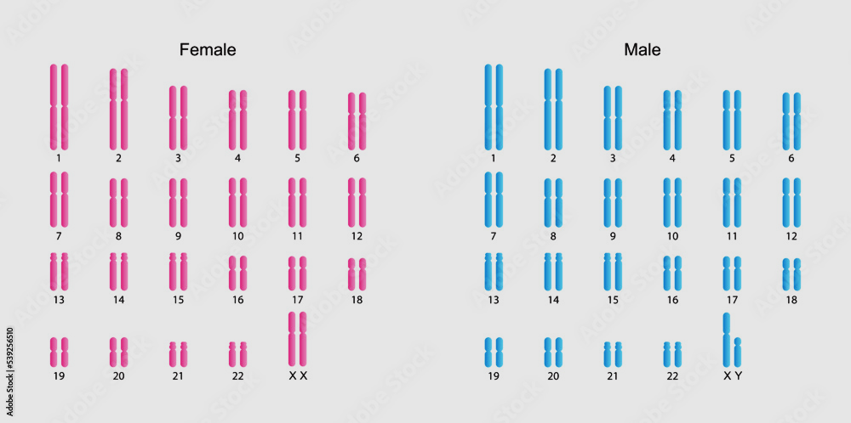
Entire set of chromosomes in humans arranged in pairs
Why are these chromosomes in pairs
Are these cells diploid or haploid?
Are these cells somatic or germ cells
How male and females are different?

Slide 25
Which one of the two germ cells may carry Y chromosome?
Sperm
Egg

Slide 26
How many sets of chromosome do we carry?
2. How many versions (alleles) of a gene can we carry if every chromosome is in pair?
3. What happens during the gamete (sperm or egg) formation (meiosis) ? Do the allele pairs stay together?

Slide 27
Some sample questions

Slide 28
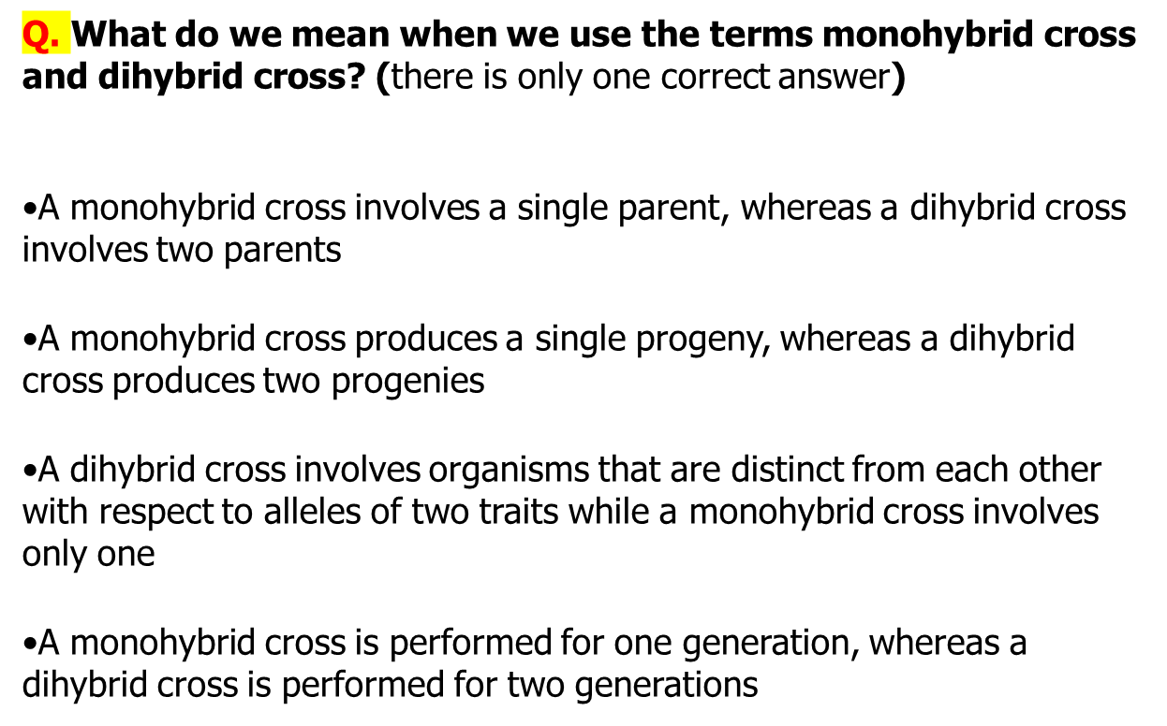

Slide 29
